Slide 1
JavaScript and the Document Object Model (DOM)

Slide 2
JavaScript is...
A client-side scripting language
Interpreted
Weakly typed
Prototype-based
Used to add interactivity to websites
Governed by ECMA International –
http://www.ecma-international.org/ecma-262/7.0/index.html

Slide 3
Client-side Scripting Language
Client-side – Processed by the browser
Compare: “server-side”
Scripting language –
Interpreted at run-time
Controls the behavior of another application
Like, say, a browser

Slide 4
Interpreted Language
Lexed and parsed by the browser
Translated into intermediate bytecode (aka pcode)
Executed by the browser
Advantage: No need to precompile, portability
Disadvantage: Overhead of preprocessing
Notes:
What is Lexed?
No need to precompile, you only need is the source code.
Portability means it will work on different browsers on different OSs

Slide 5
Weak/Loose Typing
Variable types not explicitly defined
Type coercion performed depending on context automatically (may usually be done manually)
Based on where it is being used, the type will be forced by the interpreter
Ex: PHP, JavaScript
Notes:
Type Coercion means ? . A common example is the coercion of string "5" into an integer 5 or a double 5.0.
Type Coercion is the conversion of one type of object to a new object of a different type with similar content.

Slide 6
Strong Typing
Variable types explicitly defined
Language constructs must behave according to the rules of each type
Type coercion (making one type behave as another) must be done manually
Ex: Java, C++

Slide 7
Prototype-based Language
Object-oriented – in fact, every non-primitive is an object
Behavior is reused by cloning pre-existing objects, or prototypes

Slide 8
JavaScript is useful...
Dynamically change the page
Enhance forms
Improved ways of displaying content
Special effects (in moderation!)
Asynchronous JavaScript and XML (AJAX) – Pattern used to make additional requests without leaving the page

Slide 9
...But we can't rely on it.
Not all browsers implement the same functionality
Surprise!
Users can disable JavaScript
Security concerns
Poorly-designed experiences

Slide 10
When not to use JavaScript
When it can be done in CSS
Form validation (when used exclusively)
Any functionality that is required for the functioning of your site

Slide 11
Progressive Enhancement
Start with content
Annotate with semantic HTML
Apply cross-browser CSS
Embellish CSS with less supported features after.
Add JavaScript to enhance the final experience for those users supporting it

Slide 12
Using JavaScript

Slide 13
Adding JavaScript: <script>
Within the <script> tag
Empty <script> element, with the src attribute pointing to a .js file (preferred) (like we do for <style>)
type=”text/javascript”
Required in HTML 4.01/XHTML 1.0
Optional in HTML5
Strongly recommended to use as late in the page as possible – Why?

Slide 14
Writing JavaScript

Slide 15
Language Elements
Comments
Variables
Values
Primitives
Objects
Operators
Control Structures
Functions

Slide 16
JavaScript Comments
Same line - // C++ Style Comments
Multi-line - /* C-style Comments */

Slide 17
JavaScript Variables
Variables are not the same as values
Variables are containers for either values or pointers to values
Declaring variables:
var variable = value
Example var x = 5

Slide 18
JavaScript Variable Scope
Variables scoped at the function level, not the block level
var i=0; //global
function myFunc(i) { // local
_{alert(i);}
}
function myFunc2() { // also local
var i=3;
alert(i);
}

Slide 19
<aside> Global Scope
Declaring variables without var...
Look for the variable name within scope
If it doesn't exist, variable defined on the global scope
Always use the var keyword to avoid unexpected behavior!

Slide 20
JavaScript Values
Primitives are stored completely within a variable
String - “Hello World!”
Number (float) – 3.14159, 42
Boolean – true, false
Explicit null value - null
Declared but not assigned a value – undefined
Primitives do not have properties – they are values

Slide 21
JavaScript Values
Objects are referred to by variables
When assigning var obj2 = obj1, only the reference is copied
obj1 and obj2 now point to the same object
Have properties
Types of objects
Primitive wrappers
Arrays
Other Predefined Objects
Functions
Object literals

Slide 22
JavaScript Values
Primitive wrappers for strings, numbers, boolean wrap the primitive value while providing new methods of manipulating it
Primitives will be coerced to primitive wrapper objects when necessary
ie: string.length()
var str = 'hello'; console.log(str.toUpperCase()); // --> HELLO
Notes:
https://javascriptrefined.io/the-wrapper-object-400311b29151

Slide 23
<aside> Type Coercion
When attempting to use a variable in a context where another type is expected, it will be automatically cast to the appropriate type
Implicit conversion {double d; int i; if (d < i) d=i;}
What is explicit conversion called? If ( (int) d < i) d = (double) i;}
Example on an object property:
var s = “foo”; // s is a Primitive string value
alert(s.length); // s is coerced into a string object
/* s is a primitive string value. When calling string manipulation functions on it, it is coerced to an object with the appropriate wrapper */ alert(s.length);
Notes:
Casting

Slide 24
JavaScript Control Structures
if/else if/else
Ternary operator
( (bool_test) ? truevalue : falsevalue; )
e.g. var grade = (marks > 50 ) ? “Pass” : “Fail”
for
while/do-while
For in
for (variable in object) {
/* Iterate through object's properties */
}

Slide 25
JavaScript Arrays
Arrays are objects that may be declared as an object or in array literal notation
var a = new Array();
a[0] = ”Foo”;
a[1] = 42;
var a = new Array(“Foo”, 42, true);
var a = [“Foo”, 42, true]; // literal
Also has array manipulation methods built in
push(), pop(), shift(), unshift(), etc.
Can grow dynamically
Notes:
https://developer.mozilla.org/en-US/docs/Web/JavaScript/Reference/Global_Objects/Array/shift

Slide 26
Predefined Objects
Many helpful objects are predefined by the language itself
‘document‘ represents the current page
‘window’ represents the actual browser viewport
Math contains helpful methods for advanced calculations
etc.

Slide 27
Example: JavaScript Dates
Predefined object meant to manipulate dates/times
Multiple constructors...
var d = new Date();
var d = new Date(ms);
var d = new Date(“Jan 20, 2012”);
var d = new Date(yr, mo, d, hr, min, sec, ms);
Get, set, locale, toString() methods

Slide 28
JavaScript Objects
All other objects derive themselves from the base Object()
Can be instantiated using the new keyword
var o = new Object();
Note: Instantiation via the new keyword is really cloning an existing object!
Can be declared using object literal notation
var o = {}; // literal

Slide 29
JavaScript Objects
Fundamentally, objects in JavaScript are just hashes (associative arrays)
Data structure with name => value pairs
Can be nested
var myObj = {
val1: “foo”,
val2: true,
val3: 42,
val4: [“bar”, “baz”, “bang”]
};

Slide 30
JavaScript Objects
Can refer to keys using myObj.foo or myObj[“foo”]
Latter is required if there's a dash in the name
Can add keys to existing objects once declared
myObj[“val5”] = {};
myObj.val6 = null;
Only applies to this instance!

Slide 31
JavaScript Objects
Objects keys are either properties or methods
Properties simply refer to a value
Methods have a special Function() object as their value, which is evaluated when called

Slide 32
JavaScript Functions
Functions in JavaScript are actually Function() objects
Includes object methods
Note: JavaScript is case-sensitive!
return statement required at end
Do not have to be declared in the global scope; can be nested (advanced)
Declared a number of ways...
Notes:
A JavaScript function is a block of code designed to perform a particular task.
A JavaScript function is executed when "something" invokes it (calls it).

Slide 33
JavaScript Functions
Function statement
function myFunction(arg1, arg2) { return arg1*arg2; }
Parsed when loaded
Creates a variable with the same name as the function name in the scope it was declared
Dynamic Functions
Declared at runtime
Assigned to a variable
Notes:
A JavaScript function is defined with the function keyword, followed by a name, followed by parentheses ().
Function names can contain letters, digits, underscores, and dollar signs (same rules as variables).
The parentheses may include parameter names separated by commas: (parameter1, parameter2, ...)
Function parameters are listed inside the parentheses () in the function definition.
Function arguments are the values received by the function when it is invoked.
Inside the function, the arguments (the parameters) behave as local variables.

Slide 34
JavaScript Functions
Function statement
function myFunction(arg1, arg2) { return arg1*arg2; }
Parsed when loaded
Creates a variable with the same name as the function name in the scope it was declared
Dynamic Functions
Declared at runtime
Assigned to a variable
Notes:
Function parameters are listed inside the parentheses () in the function definition.
Function arguments are the values received by the function when it is invoked.
Inside the function, the arguments (the parameters) behave as local variables.

Slide 35
Dynamic Functions
Function constructor
var fn = new Function(“arg1”, “arg2”, “return arg1*arg2;”);
Not recommended...
Function expression
var fn = function foo(arg1, arg2) {
return arg1*arg2;
};
alert(fn(2, 3));

Slide 36
Function Expressions
Expression name can be used within function scope to refer to itself
_{alert(fn(2,3)); // SWAP, 6}
var fn = function foo(arg1, arg2) {
_{if (arg1 < arg2) {}
_{alert("SWAP");}
_{return foo(arg2, arg1);}
_{} else {}
_{return arg1*arg2;}
}
};
Notes:
Show the JS_Functions_Example5

Slide 37
Anonymous Functions
Function expressions don't require a name
var fn = function(arg1, arg2) {
return arg1*arg2;
};
Many potential uses for this...

Slide 38
Parameter Passing
Function params are passed by value
Remember, object references are also values!
This means the object referred to can be manipulated within a function

Slide 39
Recursion
JavaScript supports recursion
function factorial(n) {
if (n == 0) {
return 1;
}else {
return n * factorial(n-1);
}
}
Notes:
JS_Functions_FactorialExample6

Slide 40
Creating Objects - Properties
Any named function can be used as a constructor when combined with the new keyword
var foo = new Student(“Jane”, “Smith”, “6609999999”);
function Student(fname, lname, rin) {
this.firstName = fname;
this.lastName = lname;
this.rin = rin;
}
Notes:
The special variable this always refers to the current object instance

Slide 41
this keyword
The special variable this always refers to the current object instance
Sometimes this is referred to as the activation object

Slide 42
Creating Objects - Methods
var foo = new Student(“Jane”, “Smith”, “6609999999”);
alert(foo.toString());
function Student(fname, lname, rin) {
this.firstName = fname;
this.lastName = lname;
this.rin = rin;
this.toString = function() {
return this.firstName + “ “ + this.lastName;
};
}
Notes:
JS_Functions_Object_Example8

Slide 43
<aside> Concatenation
var a = 1 + 1; // 2
var a = “1” + “1”; // 11
var a = “a1” + 1; // a11

Slide 44
What can we do with JavaScript?
Can be executed server-side
V8 JavaScript engine + node.js
Usually executed client-side
Retrieve information about the document
Manipulate the document once this information is retrieved

Slide 45
Document Object Model (DOM)

Slide 46
Document Object Model (DOM)
Standard way of referring to an XML and HTML documents
Returns to the notion of XML/HTML as a tree of nodes
Sound familiar?
Try: document.getRootNode()
Languages like JavaScript, implement the DOM to refer to the document root and its children as objects
Once accessed, possible to manipulate the document structure
Notes:
Once accessed, possible to manipulate the document structure
document.getRootNode()

Slide 47
<aside> DOM Support
It was proprietary at first, then it became a W3C standard.

Slide 48
Document Object
Type HTML Document
Always refers to the document root
Properties
offsetWidth/offsetHeight – dimensions of document
Methods
getElementById(id) – return an Element object matching the given id
createElement(tagName) – create an Element instance, which may be later added to the document tree
Notes:
Type of the Document object is HTML.

Slide 49
window Object
Type Window
Refers to the actual browser window
Properties
screen – provides information about the user's display
Methods
resizeTo(x, y) – resizes the window
Notes:
Type is Window

Slide 50
DOM Element Objects
Actual HTML/XML elements
Properties
childNodes – array of element's children, including text nodes if any (try: document.childNodes)
innerHTML – inner content of an element, read/write
Methods
appendChild(node) – Inserts a node at the end of the current node
More on this later …

Slide 51
DOM Text Nodes
Text content is treated as a node in the tree
var textnode = document.createTextNode(“Thilanka added this");
Typically seen as a child of another Element object
var heading = document.createElement("h1");
heading.appendChild(textnode);
More on this later …

Slide 52
CSS Properties
All CSS properties can be manipulated through the DOM
Use the style property
CSS properties are camelCase
document.body.style.fontFamily = “Verdana”;
More on this later …

Slide 53
DOM Events
JavaScript can be triggered in response to events
Done by implementing event listeners, called when events fire
Event triggers
User-driven (mouse/keyboard events)
Document/Window (load, resize, scroll...)
Form submissions

Slide 54
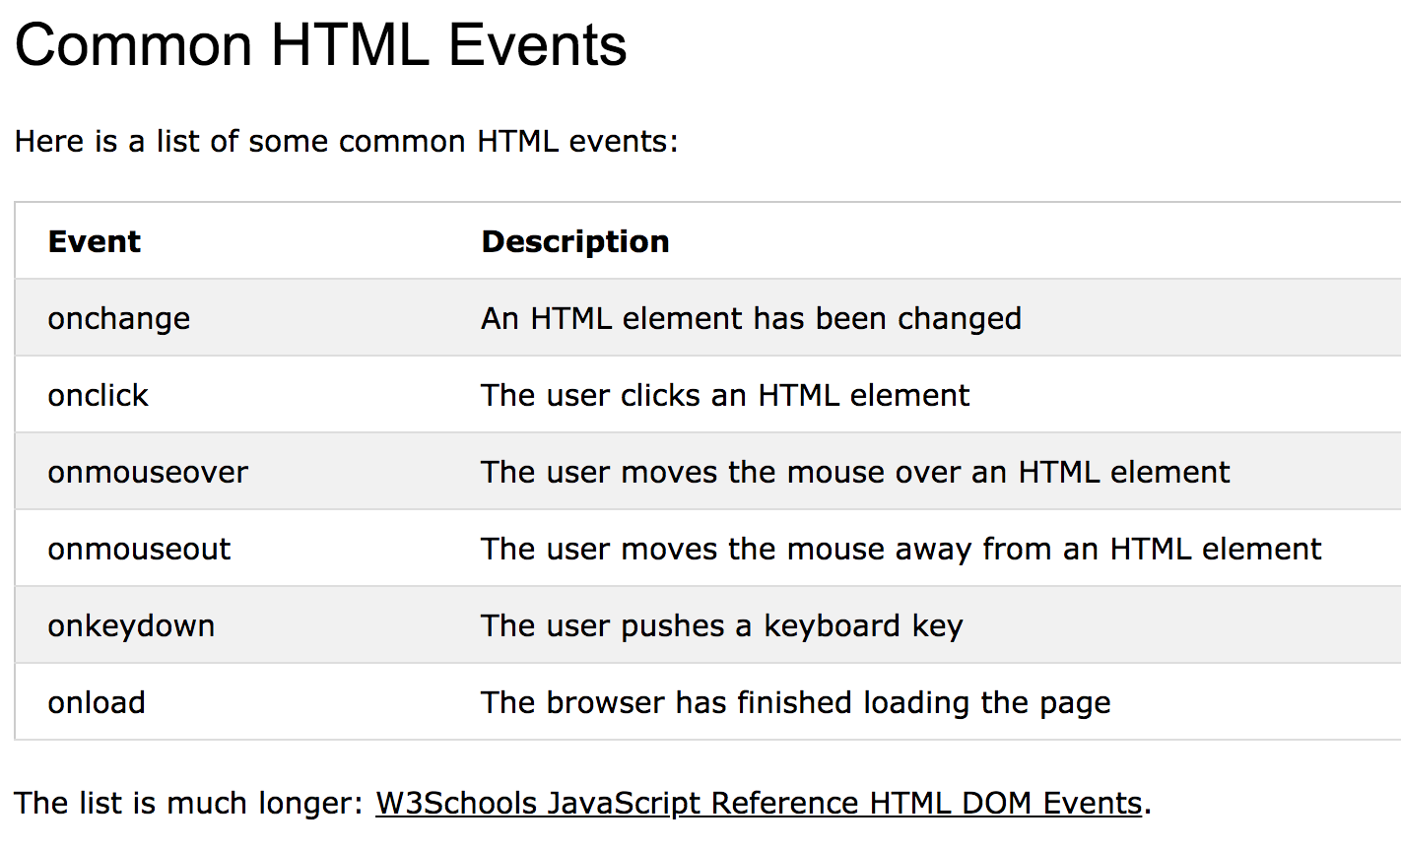
Events
Source: https://www.w3schools.com/js/js_events.asp

Slide 55
Event Handling
Find the element object
Register the event handler
element.onclick = foo;
Many other triggers exist...
Write the event handler
function foo(e) {
if (!e) var e = window.event; // Required for IE
_{/* Do stuff */}
}
Could be an anonymous function!

Slide 56
Event Objects
Whenever an event fires, information about the triggering event is passed to the event handler via an Event object
Properties of this object can be checked for more information if needed
type – Type of triggering event (mouseover, click, etc)
timeStamp – When the event occurred
Not all are compatible cross-browser!

Slide 57
Event Propagation
If an element and its child share an event handler, which fires first?
Used to depend heavily on the browser...
Netscape: “The parent!” (Event Capturing)
Microsoft: “No, the child!” (Event Bubbling)
W3C: “...Fine. You're both right!”
More on this later …

Slide 58
W3C Event Propagation
Event Capturing Phase happens first
Resolve in parent->child order
Events are captured as they descend the DOM
Event capturing ends when the target node is reached
Event Bubbling Phase happens next
Resolve in child->parent order
Events bubble up through the DOM
More on this later …

Slide 59
W3C Event Propagation
The developer can choose whether their event fires during event capturing or event bubbling
By default, element.onclick = foo; syntax uses event bubbling
More on this later …
Notes:
https://javascript.info/bubbling-and-capturing

Slide 60
</class>

